Slide 1
Course : COMP8029 – IT Security and Risk Management
Period : September / February 20XX
Business Continuity Preparation, Operations and Maintenance
Session 15
KDS – Name SME

Slide 2
Objectives
Discuss the details of how a BC plan implementation unfolds
Understand the methods used to continuously improve the BC process
Describe the steps taken to maintain the BC plan
Principles of Incident Response and Disaster Recovery

Slide 3
Introduction
BC plan is implemented when an organization needs to get critical services back in action
May take place at an alternate location if the DR plan cannot restore the primary site operations
Principles of Incident Response and Disaster Recovery

Slide 4
Implementing the BC Plan
BC plan takes over when it is clear that the organization cannot return to normal operations at the primary site immediately
Trigger point (or set point): predetermined state that causes the BC plan implementation to begin
Due to high costs, the organization should ensure that the benefits of implementing the BC plan justify its expenses
Principles of Incident Response and Disaster Recovery

Slide 5
Implementing the BC Plan (continued)
BC plan implementation involves these steps:
  Preparation for BC actions
  Relocation to alternate site (first by advance team, then main team, then the rest of the employees)
  Establishment of operations
  Return to the primary site or new permanent alternate site
Principles of Incident Response and Disaster Recovery

Slide 6
Preparation for BC Actions
BC team’s functions will always be generally the same, regardless of the type of disaster:
  Prepare to duplicate one or more of the organization’s critical functions at an alternate site
Planning and training encompasses the bulk of the preparation activities
Entire organization should be prepared for their role in a BC operation
Principles of Incident Response and Disaster Recovery

Slide 7
Preparation for BC Actions (continued)
Generally impossible to prepare for all possible contingencies, but a general training program can be developed
Command & Control (C&C) functions:
  Critical functions that are prepared for alternative deployment
  Core administrative functions required to keep the company operational for 90 days
BC team should rehearse setting up one or more of the critical functions at an alternate site
Principles of Incident Response and Disaster Recovery

Slide 8
Preparation for BC Actions (continued)
C&C functions will likely include at least:
  Customer service
  IT operations
All C&C functions may not be implementable at the same alternate BC site
Organization may be able to make changes in normal policies and procedures that will improve the effectiveness of BC preparation
Remember that standard procedures for data backup must continue at the alternate site to avoid additional disruptions
Principles of Incident Response and Disaster Recovery

Slide 9
Preparation for BC Actions (continued)
Additional preparations may include:
  Issuance of P-cards to designated BC team members
  Off-site storage of key forms in hard copy
Advance preparation pays off in efficiency when the BC plan must be implemented
Principles of Incident Response and Disaster Recovery

Slide 10
Relocation to the Alternate Site
First decision: whether essential functions should be started at the alternate site
Second decision: which services must be available
Next steps:
  Advance party is deployed to begin coordinating the move
  Key service providers are notified
  Rest of the BC team moves to the site
  Needed supplies and materials are acquired
  Affected employees are relocated and begin work
Principles of Incident Response and Disaster Recovery

Slide 11
Relocation to the Alternate Site
(continued)
Advance party should include members from each of the BC subteams
  Management team: command and control group
  Operations team: works to establish core business functions needed to sustain critical business operations
  Computer setup (hardware) team: sets up hardware in the alternate location
  Systems recovery (OS) team: installs operating systems on hardware
Principles of Incident Response and Disaster Recovery

Slide 12
Relocation to the Alternate Site
(continued)
Advance party (continued):
  Network recovery team: establishes short- and long-term networks, including hardware, wiring, and Internet and intranet connectivity
  Applications recovery team: responsible to get internal and external services up and running
  Data management team: responsible for data restoration and recovery
  Logistics team: provides any needed supplies, materials, food, services, or facilities needed at the alternate site
Principles of Incident Response and Disaster Recovery

Slide 13
Relocation to the Alternate Site
(continued)
Service providers:
  May be notified by the BC service provider or by the BC team
  Include water, power, telephone, data services
BC team leader must notify HR that the BC plan has been activated
Where possible, supplies and equipment should be prepurchased and prepositioned at the alternate site
If not possible, the requirements should be predetermined to allow rapid ordering and procurement
Principles of Incident Response and Disaster Recovery

Slide 14
Relocation to the Alternate Site
(continued)
Staff relocation:
  Should be coordinated to occur at the earliest possible point in time
  Provide logistics guidance to incoming employees
Provide organized check-in procedures to help employees quickly assimilate into the new environment
Principles of Incident Response and Disaster Recovery

Slide 15
Returning to a Primary Site
Tasks involved in returning to the primary site include:
  Scheduling employee move
  Clearing the BC site
  Conducting the after-action review (AAR)
Easiest scheduling for the move back is over a weekend
Data operations should make all normal backups first before relocating
Principles of Incident Response and Disaster Recovery

Slide 16
Returning to a Primary Site (continued)
Other activities include:
  Disconnecting temporary services
  Disassembling equipment
  Packaging recovered equipment and supplies
  Storage or transportation of recovered equipment and supplies
  Clearing the assigned BC space
  Returning control to the BC space provider
Expect a transition period for employees after the return
Principles of Incident Response and Disaster Recovery

Slide 17
Returning to a Primary Site (continued)
Employee issues may include:
  Dealing with personal issues caused by a widespread disaster
  Need to resume all duties, instead of just the critical functions performed at the BC site
  Readjusting to regular management hierarchies
  Possible changes in procedures and functions based on lessons learned while at the BC site
Principles of Incident Response and Disaster Recovery

Slide 18
BC After-Action Review
After relocation back to the primary site, the BC team must conduct the after-action review (AAR)
Each team member should come prepared with notes and suggestions
Lessons learned should be incorporated into the BC plan
Principles of Incident Response and Disaster Recovery

Slide 19
Continuous Improvement of the BC Process
Change is inevitable, in the marketplace and in a business’s interactions with the marketplace
Continuous monitoring and review of the BC processes is required to ensure their effectiveness when needed
Principles of Incident Response and Disaster Recovery

Slide 20
Improving the BC Plan
Ever-increasing reliance on information systems and technological infrastructure in business
Problem areas in the BC planning process include:
  Over-reliance on a BC plan that has not been updated frequently enough
  Scope of the BC plan is limited to systems recovery
  Faulty prioritization of critical business functions
  Lack of formal mechanisms for updating the plan
  Lack of executive ownership of the process
Principles of Incident Response and Disaster Recovery

Slide 21
Improving the BC Plan (continued)
Problem areas (continued):
  Overlooking or under-prioritizing key communications issues
  Lack of security considerations for BC operations, leading to greater risk exposure during recovery operations
  Failure to plan for public relations during disasters, leading to failure to control public and investor perceptions
  Failure to manage the insurance claims process, resulting in delayed or reduced settlements
  Failure to adequately evaluate service providers
Principles of Incident Response and Disaster Recovery

Slide 22
Improving the BC Plan (continued)
Important points to consider (from Katherine Lucey, Fellow of the Business Continuity Institute):
  A BC plan is not a single unified plan; it is a set of specialized plans
  Individual default response (IDR) should be coded into the plan by name and on individual wallet cards
  Use an automated notification system because human calling trees are not reliable
  Keep detailed reference information off-site and out of the plan
  The best recovery is one that does not have to happen: identify and eliminate as many risks as possible
Principles of Incident Response and Disaster Recovery

Slide 23
Improving the BC Plan (continued)
Important points to consider (continued):
  Start planning with the most likely types of interruptions, and then work up to the worst case scenario
  Hire a BC specialist to help develop your plan
Principles of Incident Response and Disaster Recovery

Slide 24
Improving the BC Staff
Provide training and encourage professionalism in the BC team members
Include both managerial and technical training, as well as formal BCP training
Training choices include:
  Continuing education classes
  Private professional training institutes
  National conferences
Principles of Incident Response and Disaster Recovery

Slide 25
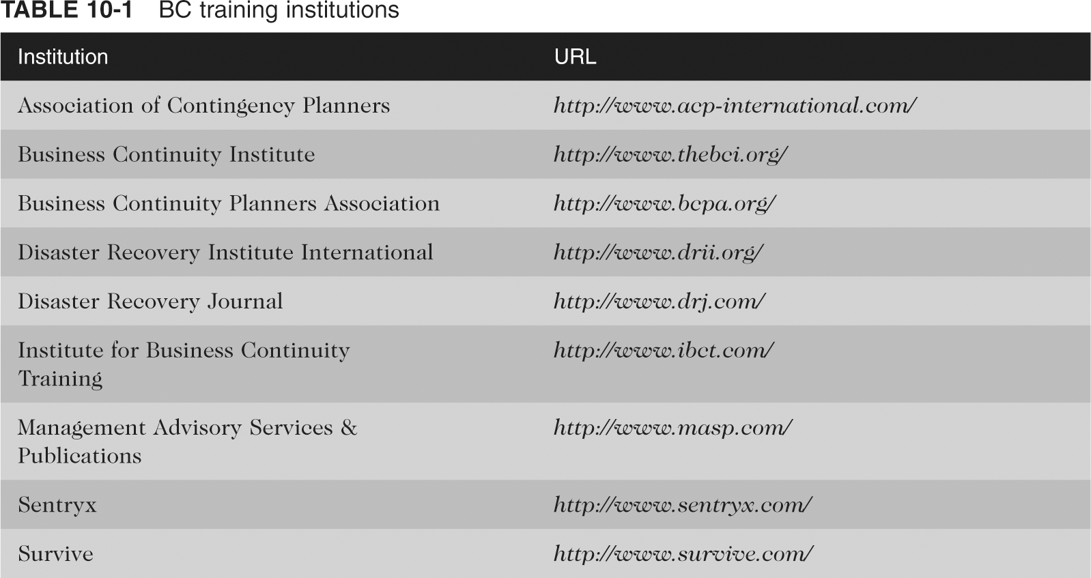
Improving the BC Staff (continued)
Principles of Incident Response and Disaster Recovery

Slide 26
Improving the BC Staff (continued)
Consider attaining BC professional certification
Currently there are two dominant professional institutions that certify business continuity professionals:
  Business Continuity Institute (BCI)
  DRI International (DRII)
Principles of Incident Response and Disaster Recovery

Slide 27
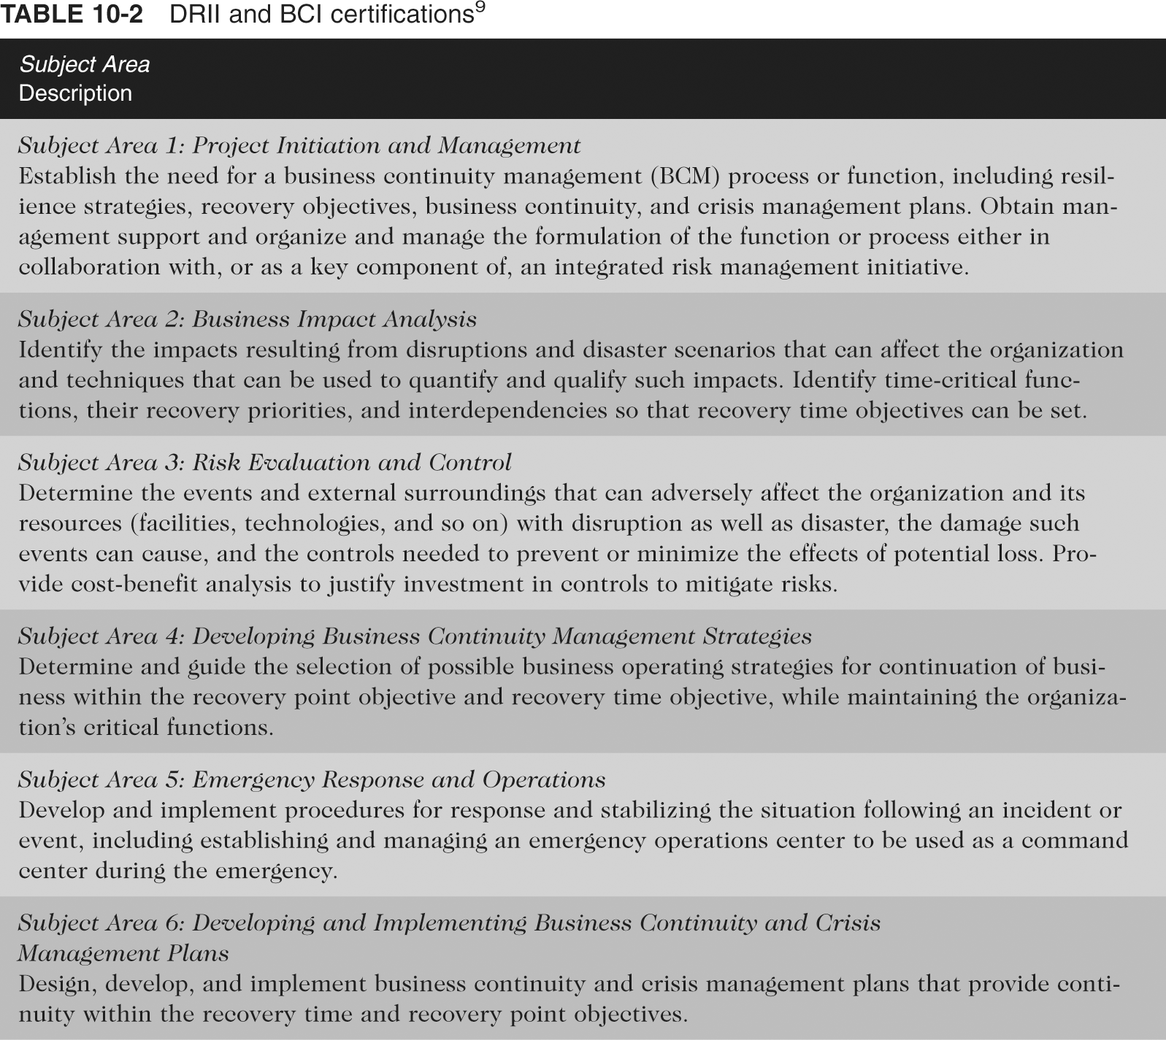
Improving the BC Staff (continued)
Principles of Incident Response and Disaster Recovery

Slide 28
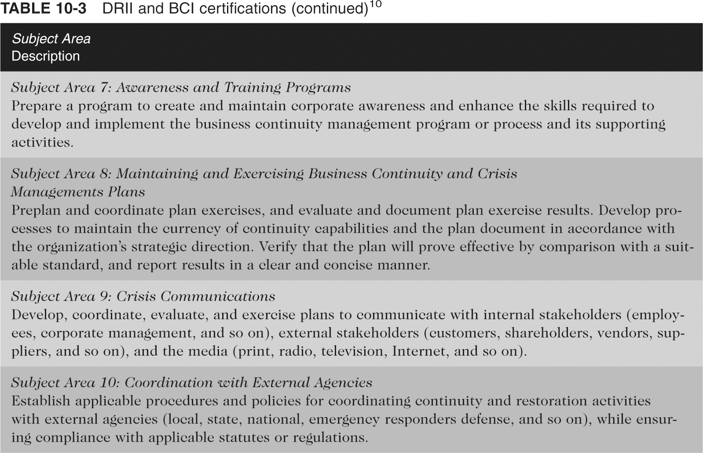
Improving the BC Staff (continued)
Principles of Incident Response and Disaster Recovery

Slide 29
Maintaining the BC Plan
BC plan requires a formal maintenance and update strategy
Formal review should occur at least annually
If the organization is in a very dynamic environment, the plan should be reviewed more frequently
Principles of Incident Response and Disaster Recovery

Slide 30
The Periodic BC Review
BC review serves the following purposes:
  A refresher on the contents of the plan
  An assessment of the suitability of the plan
  An opportunity to reconcile BC activities with other regulatory activities
  An opportunity to make needed minor changes that have been documented but not implemented since the last form review
All suggestions for improvement should go through a formal review before incorporation into the plan
Principles of Incident Response and Disaster Recovery

Slide 31
BC Plan Archivist
One individual should be responsible for the maintenance of the BC document, including:
  Incorporating approved revisions
  Redistribution of the revised plan
  Collection and secure destruction of previous versions
Principles of Incident Response and Disaster Recovery

Slide 32
Summary
Implementation of the BC plan occurs when the organization realizes it cannot resume essential operations at the primary site
Implementation includes preparations for BC actions, relocating to the alternate site, establishing operations, and returning to the primary site
All employees should minimally receive generalized training for BC activities
Advance party should include representative of each of the major BC subteams
Principles of Incident Response and Disaster Recovery

Slide 33
Summary (continued)
Supplies and equipment must be procured for the alternate site before relocating employees
Final event at the alternate site is the relocation back to the primary site
After relocation back to primary site, the BC team should conduct the after-action review (AAR)
BC plan maintenance is an on-going process
BC team members should receive BC training
Certification of BC team members should be considered
Principles of Incident Response and Disaster Recovery

